Slide 1
Multiple Logistic Regression
Cesar Acosta Ph.D.
Department of Industrial and Systems Engineering
University of Southern California

Slide 2
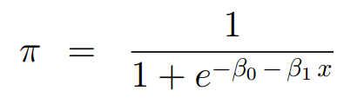
Simple Logistic regression
As x increases, π varies along the logistic cdf
where x is the predictor

Slide 3
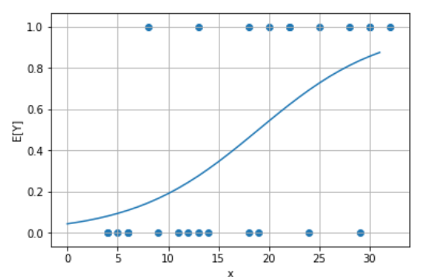
Simple Logistic regression
x

Slide 4
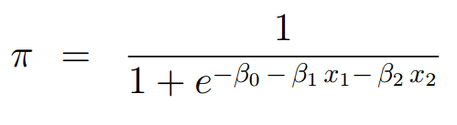
Multiple Logistic regression – Two predictors
π varies along the surface
where x₁ and x₂ are the predictors

Slide 5
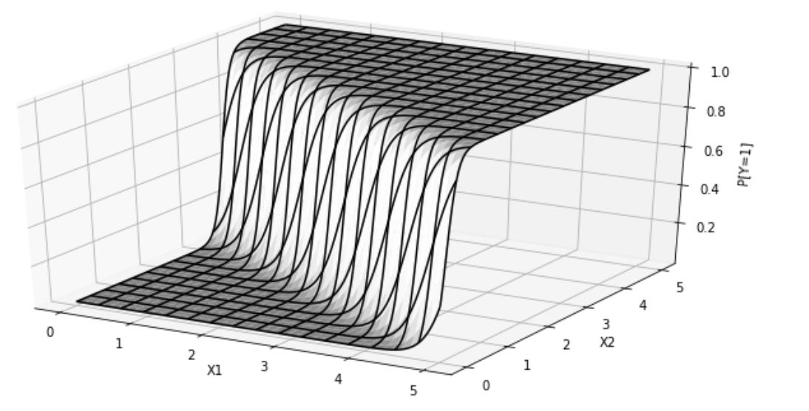
Multiple Logistic regression – Two predictors
π varies along the surface

Slide 6
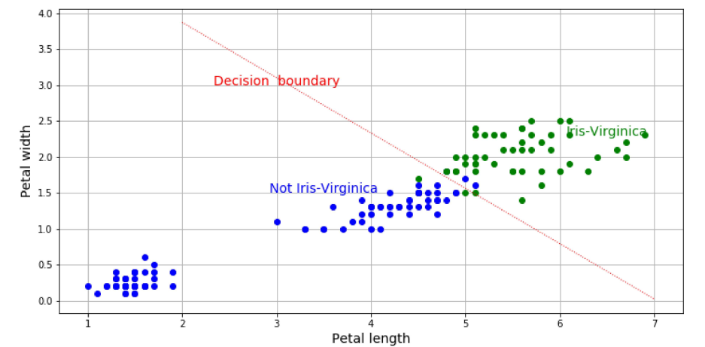
Multiple Logistic regression – Decision boundary
.

Slide 7
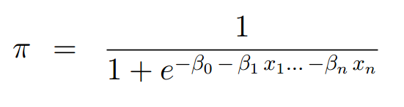
Multiple Logistic regression – n predictors
π varies along the surface
where x₁ , x₂ ,… x_{n} are
numerical and/or categorical predictors

